Slide 1
Flight Price Prediction PPT
A PowerPoint presentation containing problem statement and understanding, EDA steps and visualizations, Steps and assumptions used to complete the project, model dashboard, finalized model, and conclusion.

Slide 2
Problem Statement
Anyone who has booked a flight ticket knows how unexpectedly the prices vary. The cheapest available ticket on a given flight gets more and less expensive over time. This usually happens as an attempt to maximize revenue based on - 1. Time of purchase patterns (making sure last-minute purchases are expensive) 2. Keeping the flight as full as they want it (raising prices on a flight which is filling up in order to reduce sales and hold back inventory for those expensive last-minute expensive purchases) So, you have to work on a project where you collect data of flight fares with other features and work to make a model to predict fares of flights.

Slide 3
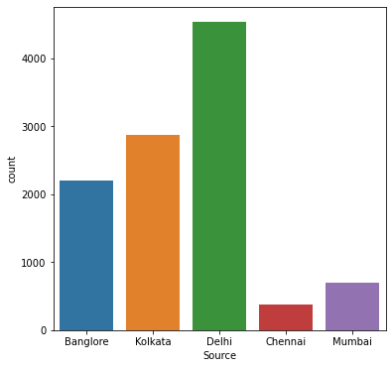
Data Visualization

Slide 4
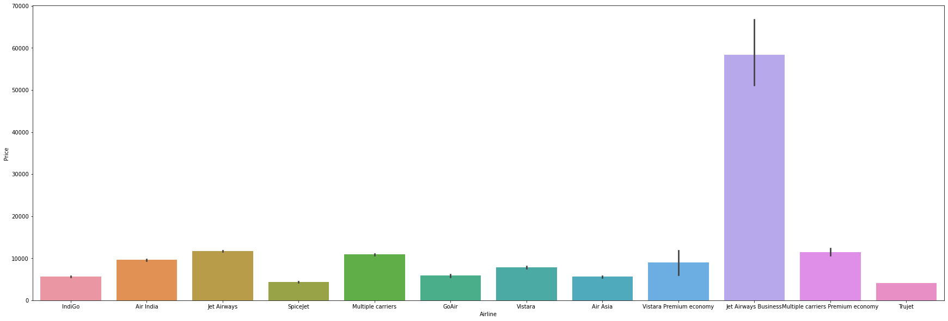

Slide 5
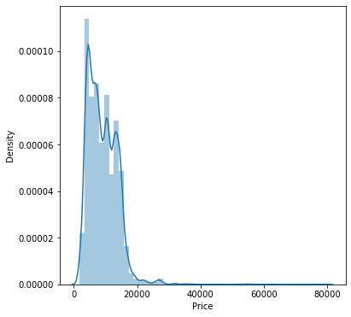

Slide 6
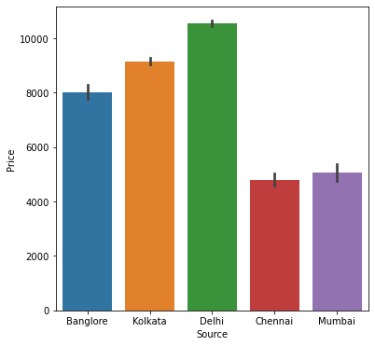

Slide 7
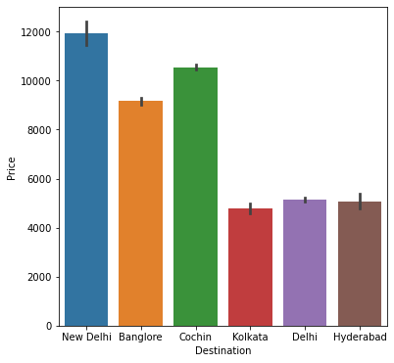

Slide 8
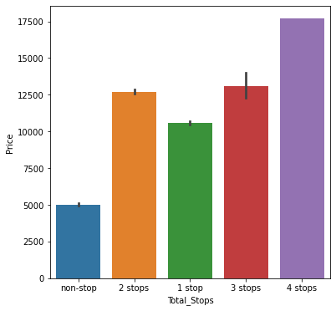

Slide 9
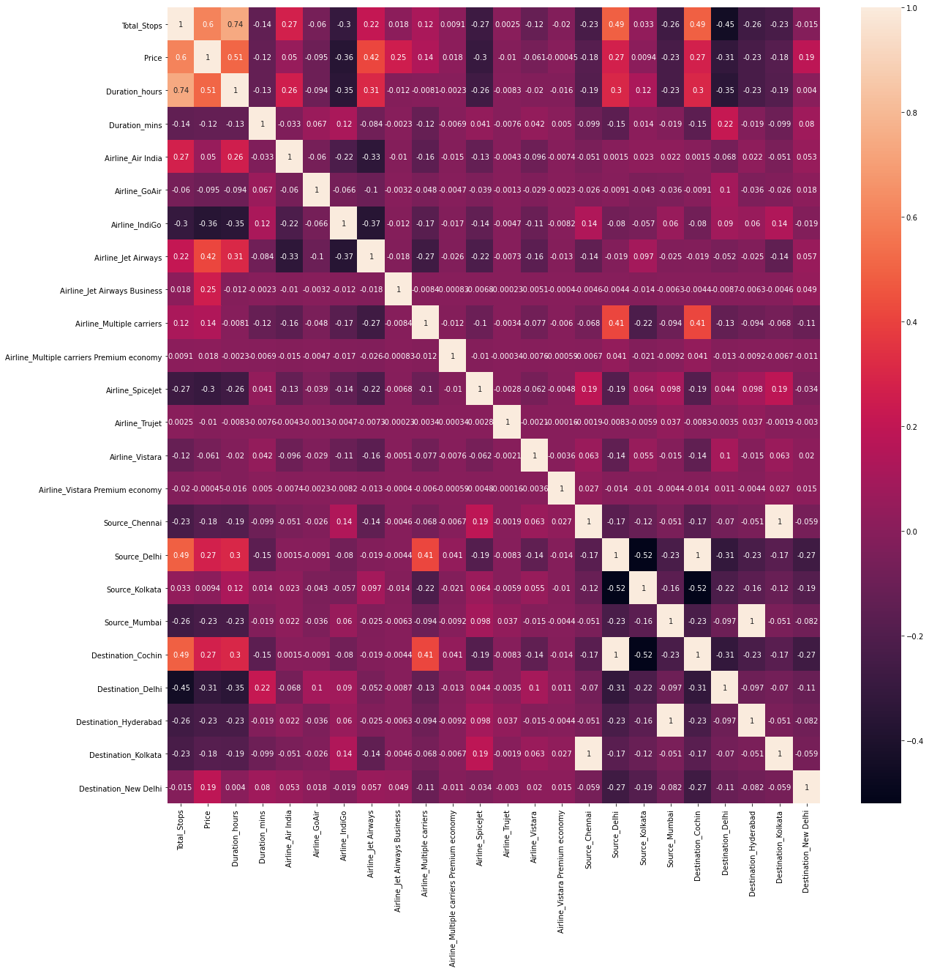

Slide 10
Model’s Training
Model’s used for the classification and regression

Slide 11
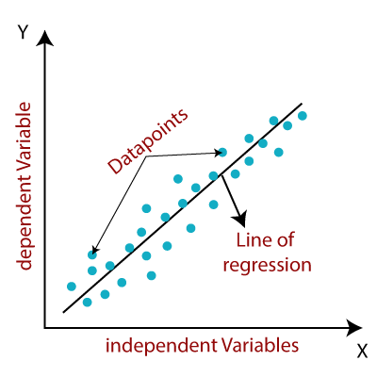
1. Linear Regression Model –
Linear regression is one of the easiest and most popular Machine Learning algorithms. It is a statistical method that is used for predictive analysis. Linear regression makes predictions for continuous/real or numeric variables such as sales, salary, age, product price, etc.
Linear regression algorithm shows a linear relationship between a dependent (y) and one or more independent (y) variables, hence called as linear regression. Since linear regression shows the linear relationship, which means it finds how the value of the dependent variable is changing according to the value of the independent variable.

Slide 12
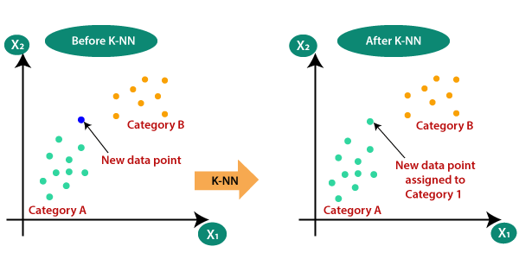
2. KNeighborsRegressor -
This algorithm is used for Classification and Regression. In both uses, the input consists of the k closest training examples in the feature space. On the other hand, the output depends on the case.
In K-Nearest Neighbors Classification the output is a class membership.
In K-Nearest Neighbors Regression the output is the property value for the object.
K-Nearest Neighbors is easy to implement and capable of complex classification tasks.

Slide 13
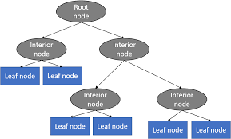
3. DecisionTreeRegressor Model -
Decision Tree is a decision-making tool that uses a flowchart-like tree structure or is a model of decisions and all of their possible results, including outcomes, input costs, and utility.
Decision-tree algorithm falls under the category of supervised learning algorithms. It works for both continuous as well as categorical output variables.
The branches/edges represent the result of the node and the nodes have either:
Conditions [Decision Nodes]
Result [End Nodes]

Slide 14
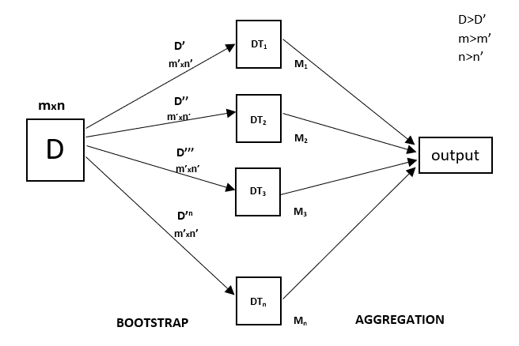
4. RandomForestRegressor Model -
A Random Forest is an ensemble technique capable of performing both regression and classification tasks with the use of multiple decision trees and a technique called Bootstrap and Aggregation, commonly known as bagging. The basic idea behind this is to combine multiple decision trees in determining the final output rather than relying on individual decision trees.
Random Forest has multiple decision trees as base learning models. We randomly perform row sampling and feature sampling from the dataset forming sample datasets for every model. This part is called Bootstrap.

Slide 15
5. AdaBoostRegressor -
Adaboost stands for Adaptive Boosting and it is widely used ensemble learning algorithm in machine learning. Weak learners are boosted by improving their weights and make them vote in creating a combined final model. In this post, we'll learn how to use AdaBoostRegressor class for the regression problem. AdaboostRegressor starts fitting the regressor with the dataset and adjusts the weights according to error rate.

Slide 16
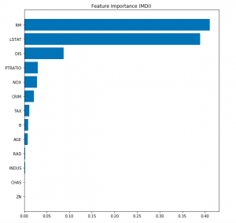
6. GradientBoostingRegressor -
Gradient Boosting algorithm is used to generate an ensemble model by combining the weak learners or weak predictive models. Gradient boosting algorithm can be used to train models for both regression and classification problem. Gradient Boosting Regression algorithm is used to fit the model which predicts the continuous value.
Gradient boosting builds an additive mode by using multiple decision trees of fixed size as weak learners or weak predictive models. The parameter, n_estimators, decides the number of decision trees which will be used in the boosting stages. Gradient boosting differs from AdaBoost in the manner that decision stumps (one node & two leaves) are used in AdaBoost whereas decision trees of fixed size are used in Gradient Boosting.

Slide 17
Conclusion
So here 'KNeighborsRegressor' is the best model out of all model tested above
which gives score - 0.588625 which is the greatest.

